Slide 1

Are throw-ins important in soccer?
Rithic Kumar N
B.Tech Computer Engineering
Indian Institute of Information Technology, Design and Manufacturing,Kancheepuram
Link to materials
Abbreviated abstract:
Throw-ins are the most common set-pieces in soccer. Given their frequent occurrence, do throw-ins play any role in contributing to how well a team performs? This poster tries to determine whether throw-in performance correlates with a team’s performance by taking xGD/90 as a proxy.
Related publications:
– Stone JA, Smith A, Barry A. The undervalued set piece: Analysis of soccer throw-ins during the English Premier League 2018–2019 season. International Journal of Sports Science & Coaching. 2021;16(3):830-839
– McKinley E. Game of throw-ins. American soccer analysis, https://www.americansocceranalysis.com/home/2018/11/27/game-of-throw-ins
rithic40@gmail.com

Slide 2
Question
Data
A throw-in is awarded to the opponents of the player who last touched the ball when the ball completely passes over the touchline, on the ground or in the air
Throw-in are the most common set-piece events in soccer
Average of ~44 throw-ins per match
However, throw-ins are not discussed as elaborately as other set-pieces like Corners or Free-kicks
Previous study by McKinley¹ and Stone et al² looked at throw-in types and possession retention in MLS(15-18) and PL (18/19 )
Does possession retention still correlate with team performance?
Which teams create chances from throw-ins ? Which teams retain the ball well after throw-ins ?
Event data from English Premier League season 20/21 (provided by @prstrggr)
For evaluating each throw-in, we look at each “possession” starting from throw-in
How long does the team retain possession
How does the possession end
Where does the possession end
Limitations
This study is limited only to PL 20/21. More data can lead to better conclusions
As we do not have player positions, we cannot take into account pressing of opposition in throw-in sequences
rithic40@gmail.com

Slide 3
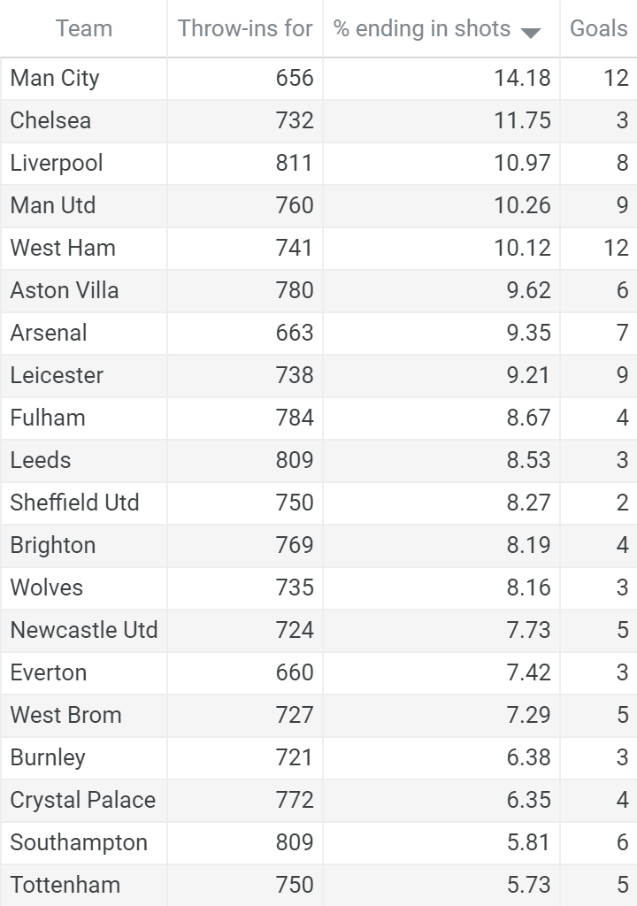
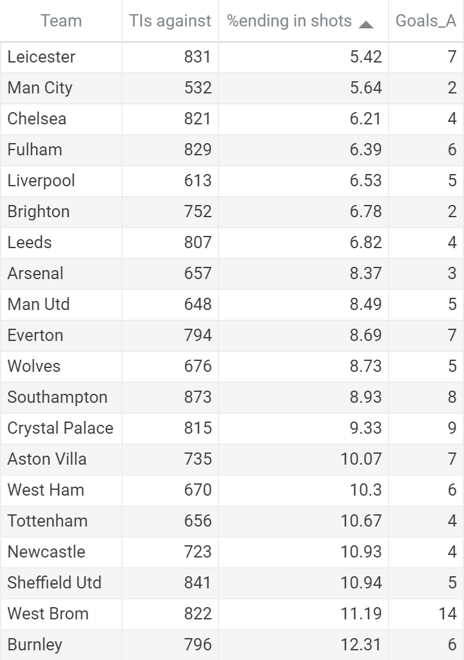
Methods Results (1)
We define a “possession” starting from a throw-in as a sequence of open-play on-ball events. A “possession” can end when
Opposition are able to establish possession of the ball (Must perform at least 3 successful actions consecutively)
Any disturbance in play occurs (Shots , Corners , Fouls, Throw-in, Claims, GK pickup etc)
For each possession, we calculate
the duration and
Change in probability of scoring between end and start location of the possession as a proxy for evaluating ball progression from throw-in possessions
Offensive performance of Throw-ins
Defensive performance of Throw-ins
rithic40@gmail.com

Slide 4
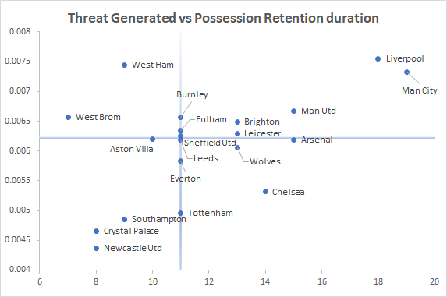
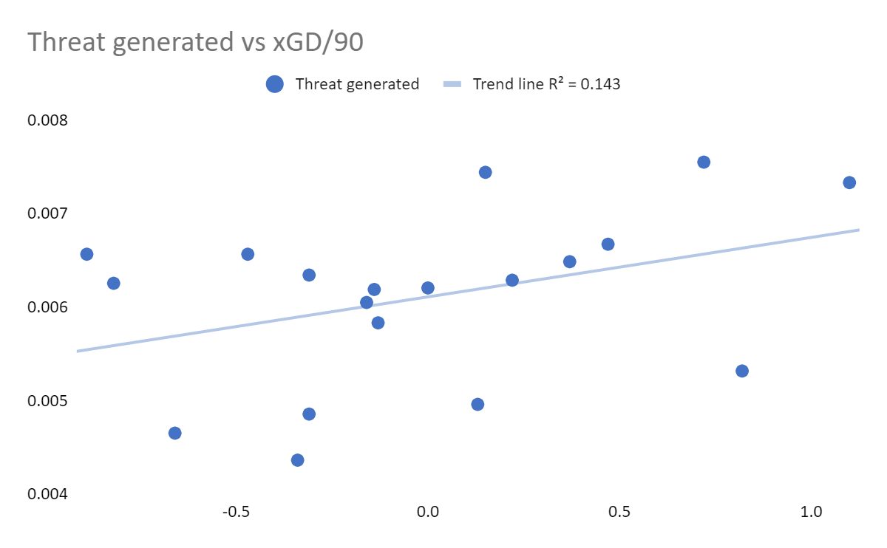
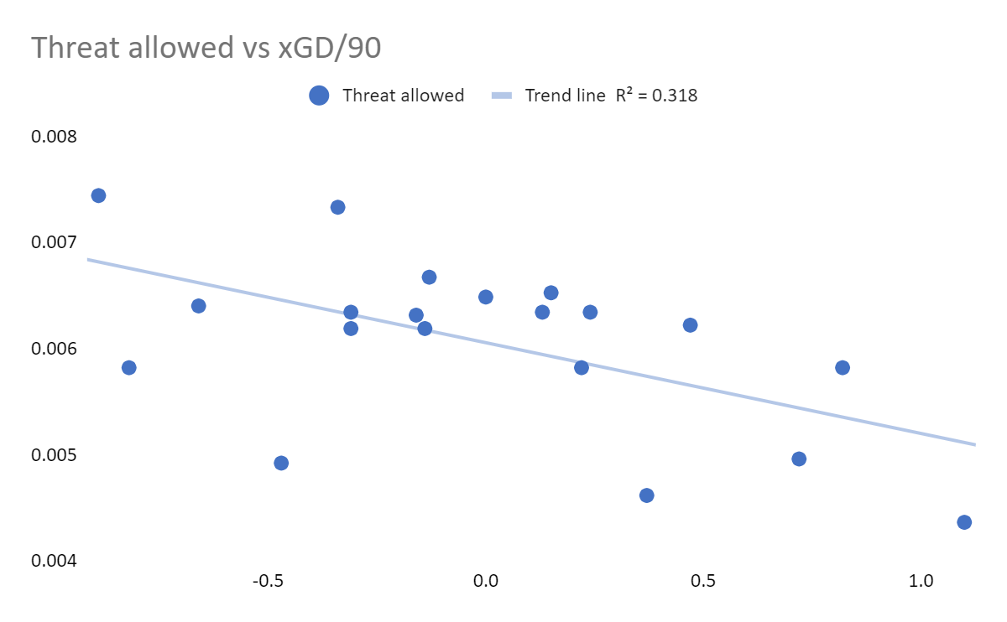
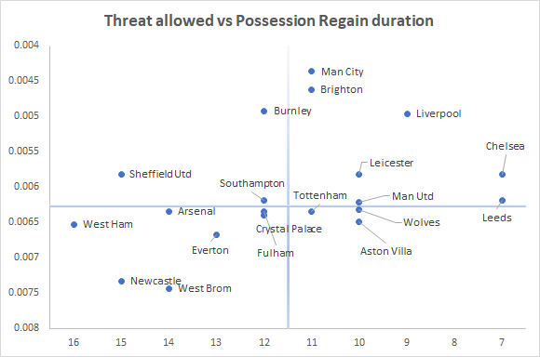
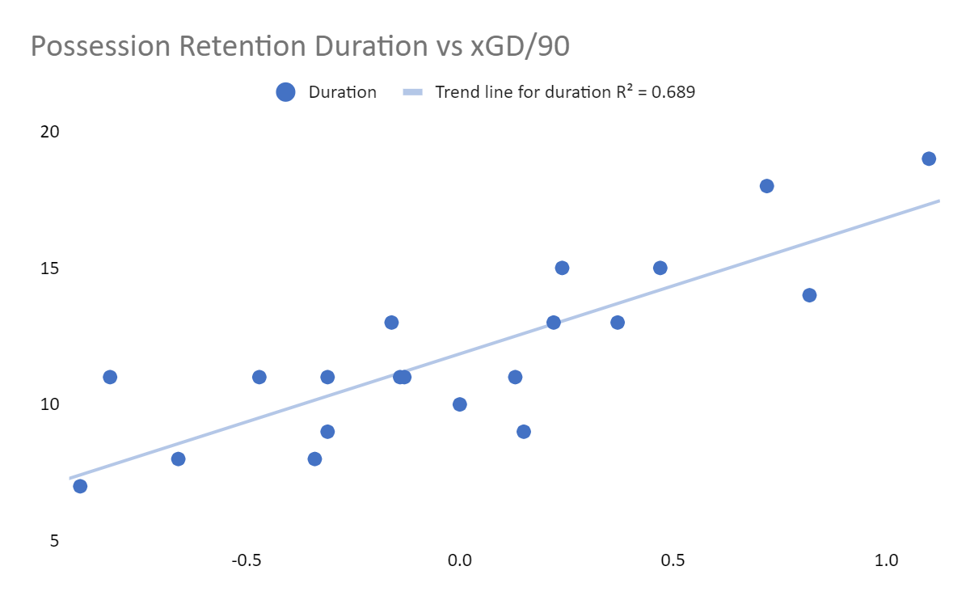
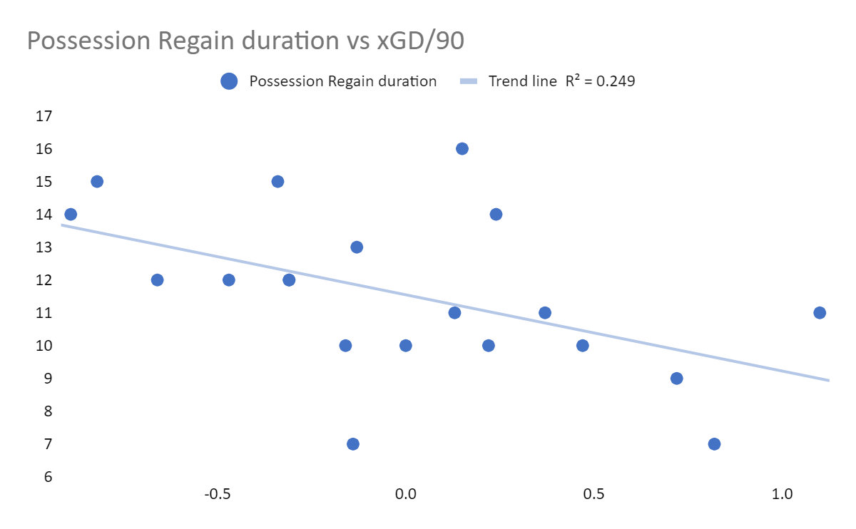
Results (II) and Conclusions
KEY TAKEAWAYS:
Attacking throw-ins:
Possession Retention duration→ strong +ve correlation with team performance
Ball Progression → No significant correlation with team performance
Defending throw-ins:
Possession Regain duration→ -ve correlation with team performance
Ball progression → -ve correlation with team performance
Throw-in Offensive performance
Progress ball well
Retain ball longer
Use xGD/90 as a marker for team performance
Throw-in Defensive performance
Stop ball progression well
Regain ball quickly

